Slide 1
Knowledge and Reasoning

Slide 2
Knowledge-Based Agent in Artificial intelligence
An intelligent agent needs knowledge about the real world for taking decisions and reasoning to act efficiently.
Knowledge-based agents are those agents who have the capability of maintaining an internal state of knowledge, reason over that knowledge, update their knowledge after observations and take actions.
Knowledge-based agents are composed of two main parts:
  Knowledge-base
  Inference system.
A knowledge-based agent must able to do the following:
An agent should be able to represent states, actions, etc.
An agent Should be able to incorporate new percepts
An agent can update the internal representation of the world
An agent can deduce the internal representation of the world
An agent can deduce appropriate actions.

Slide 3
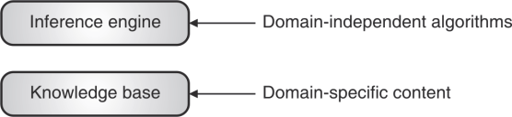
A Knowledge Based Agent
Levels of knowledge base

Slide 4
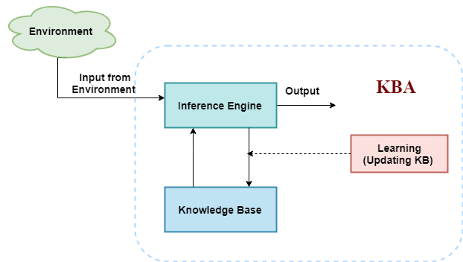
Architecture of a KB Agent

Slide 5
Architecture of a KB Agent
The above diagram is representing a generalized architecture for a knowledge-based agent. The knowledge-based agent (KBA) take input from the environment by perceiving the environment. The input is taken by the inference engine of the agent and which also communicate with KB to decide as per the knowledge store in KB. The learning element of KBA regularly updates the KB by learning new knowledge.

Slide 6
Knowledge-base
Knowledge-base is a central component of a knowledge-based agent. It is a collection of sentences (here 'sentence' is a technical term and it is not identical to sentence in English). These sentences are expressed in a language which is called a knowledge representation language. The Knowledge-base of KBA stores fact about the world.
Why use a knowledge base?
Knowledge-base is required for updating knowledge for an agent to learn with experiences and take action as per the knowledge.

Slide 7
Operations Performed by KBA
Following are three operations which are performed by KBA in order to show the intelligent behavior:
TELL: This operation tells the knowledge base what it perceives from the environment.
ASK: This operation asks the knowledge base what action it should perform.
Perform: It performs the selected action.

Slide 8
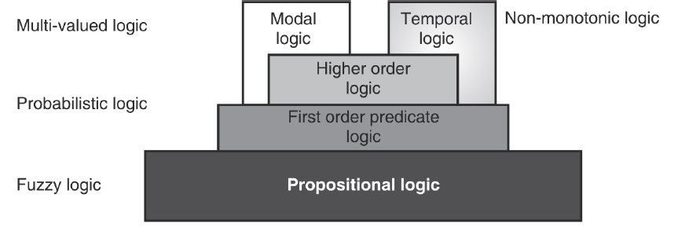
Role of Reasoning in AI

Slide 9
Representation of Knowledge using Rules
Knowledge can be considered to be represented at generally two levels
(i) Knowledge level : This level describes the facts.
(ii) Symbol level : This level deals with using the symbols for representing the objects, which can be manipulated in programs.
Knowledge can be represented using the following rules
(a) Logical representations
(b) Production rule representations
(c) Semantic networks

Slide 10
(a)Logical representations
The logical representations are mostly concerned with truth of statements regarding the world. These statements are most generally represented using statements like TRUE or FALSE.
− Logic is successfully used to define ways to infer new sentences from the existing ones. There are certain logics that are used for the representation of information, and range in terms of their expressiveness.
There are logic that are more expressive and are more useful in translation of sentences from natural languages into the logical ones.

Slide 11
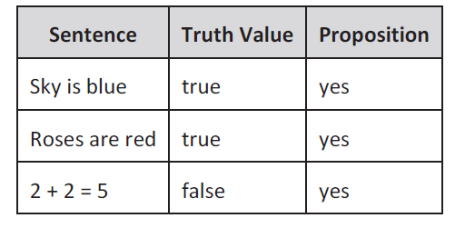
Ways of logical representations
1. Propositional logic : These are restricted kinds that make use of propositions (sentences that are either true or false but not both) which can be either true or false. Proposition logic is also known as propositional calculus, sentential calculus or Boolean algebra.
All propositions are either true or false, For example :
(i) Leaves are green (ii) Violets are blue.

Slide 12
Ways of logical representations
2. First order predicate logic : These are much more expressive and make use of variables, constants, predicates, functions and quantifiers along with the connectives.
3. Higher order predicate logic: Higher order predicate logic is distinguished from first order predicate logic by using additional quantifiers and stronger semantics.
4. Fuzzy logic : These indicate the existence of in between TRUE and FALSE or fuzziness in all logics.

Slide 13
(b) Production rule representation
One of the widest used methods to represent knowledge is to use production rules, it is also known as IF-THEN rules.
Syntax :
IF condition THEN action
IF premise THEN conclusion
IF proposition p1 and proposition p2 are true THEN proposition p3 is true
Example :
IF pressure is high, THEN volume is small.
IF the road is slippery, THEN driving is dangerous.
− Some of the benefits of IF-THEN rules are that they are modular, each defining a relatively small and, at least in principle, independent piece of knowledge. New rules may be added and old ones deleted usually independently of other rules.

Slide 14
(c) Semantic networks
These represent knowledge in the form of graphical networks, since graphs are easy to be stored inside programs as they are concisely represented by nodes and edges.
− A semantic network basically comprises of nodes that are named and represent concepts, and labelled links representing relations between concepts. Nodes represent both types and tokens.

Slide 15
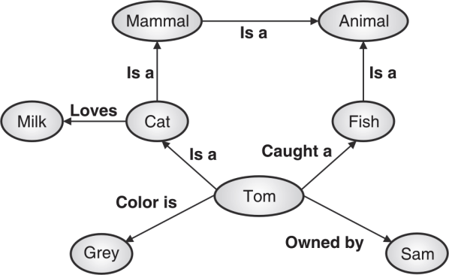
Example
For example, the semantic network in Fig. expresses the knowledge to represent the following data :
Tom is a cat.
Tom caught a fish.
Tom is grey in color.
Tom is owned by Sam.
Tom is a Mammal.
Fish is an Animal.
Cats love Milk.
All mammals are animals

Slide 16
Example

Slide 17
Propositional Logic (PL)
− Propositional Logic (PL) is simple but powerful for some artificial intelligence problems.
− In case of artificial intelligence propositional logic is not categorized as the study of truth values, but it is based on relativity of truth values. (i.e. The relationship between the truth value of one statement to that of the truth value of other statement)

Slide 18
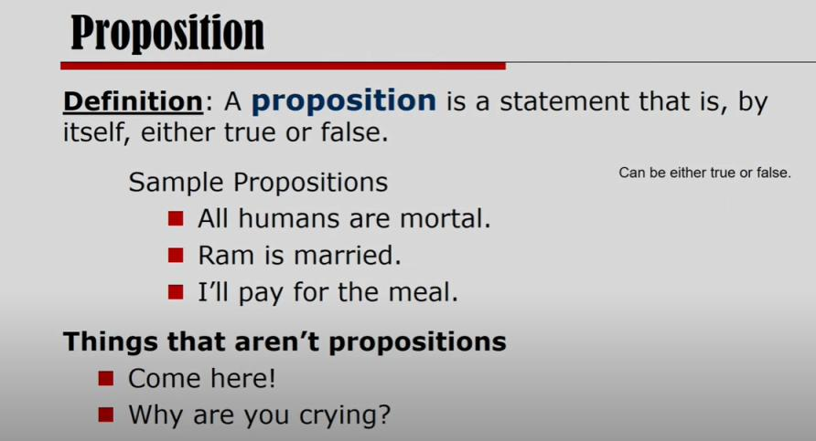


Slide 19
Topics Covered in the last class
Architecture of Knowledge Base agent
Basic Components of Knowledge Base agent
Ways of representing Knowledge
(a) Logical representations
Proposition Logic
First Order Logic
(b) Production rule representations
(c) Semantic networks

Slide 20
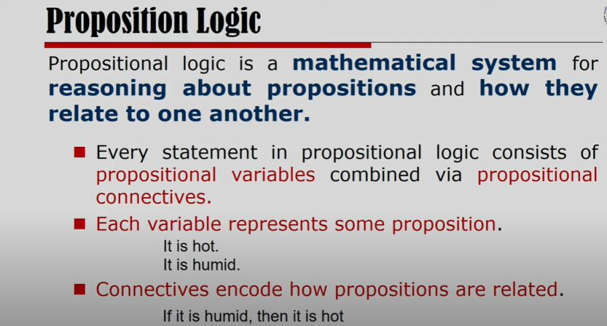

Slide 21
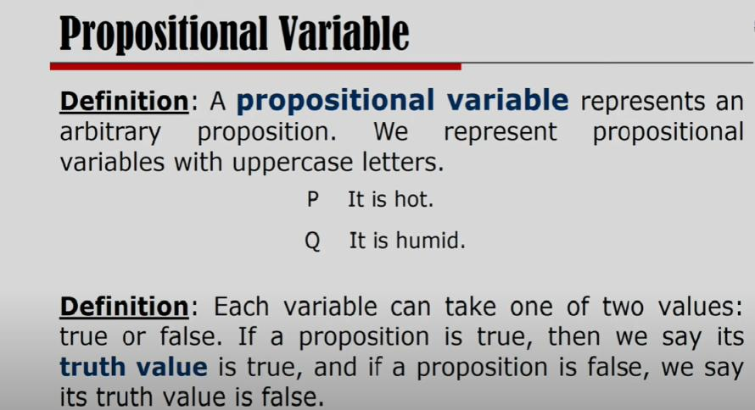

Slide 22
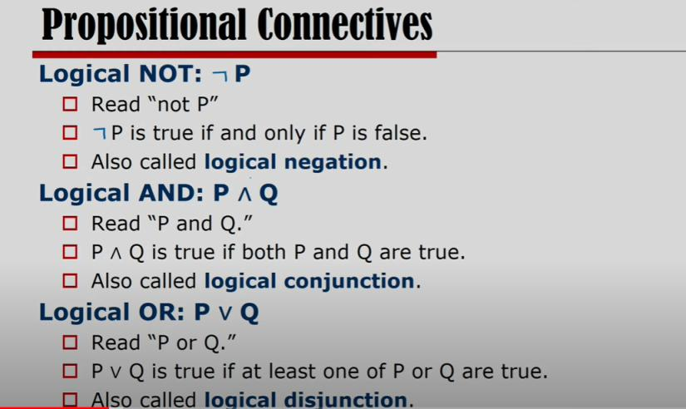

Slide 23
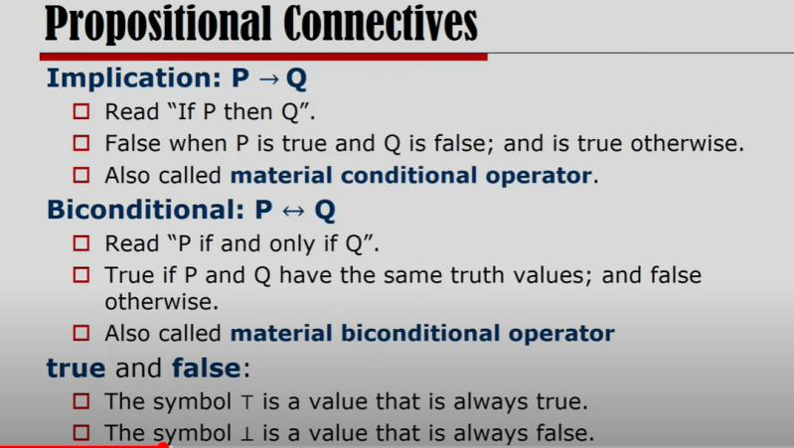

Slide 24
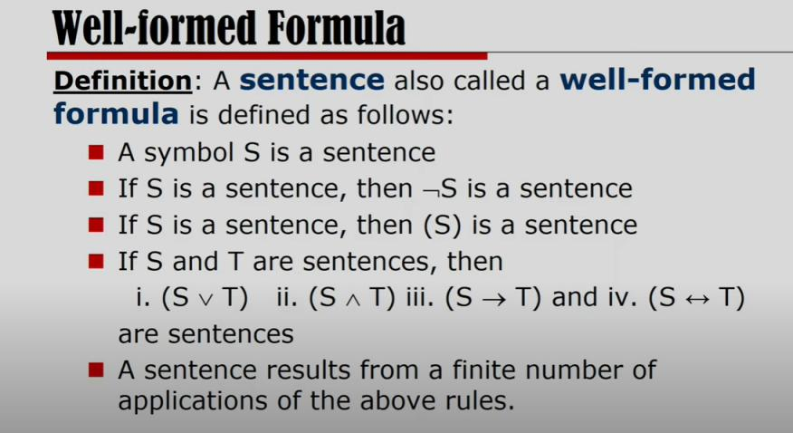

Slide 25
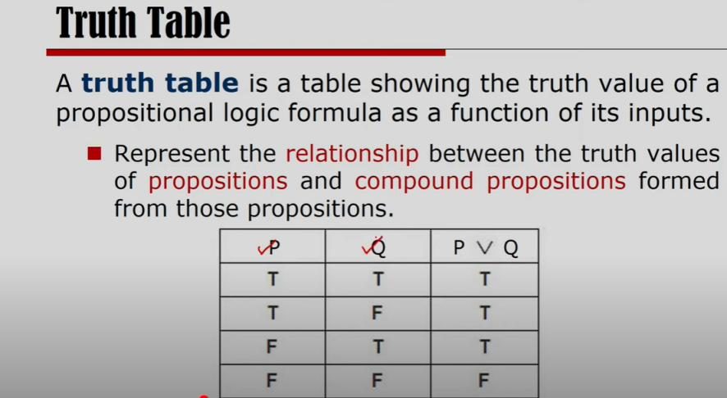

Slide 26
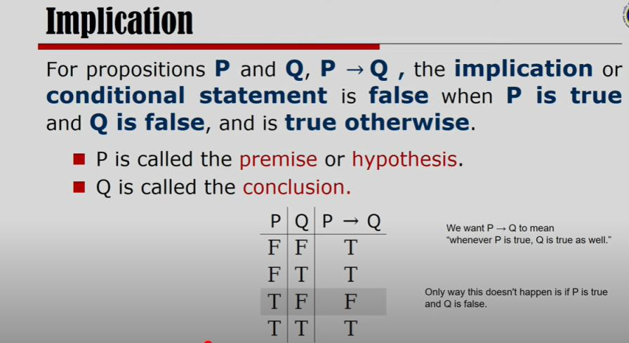

Slide 27
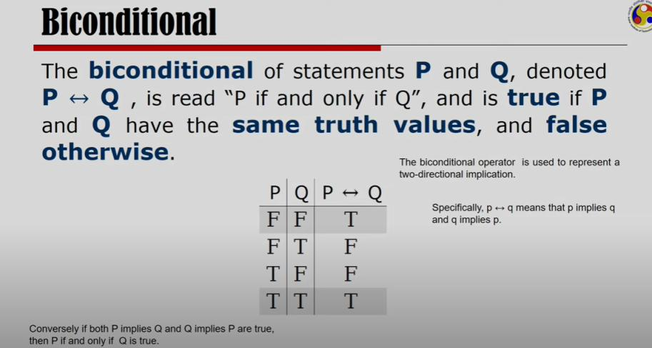

Slide 28
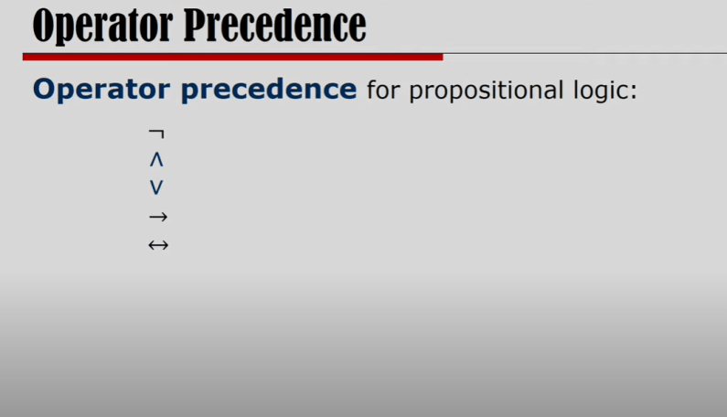

Slide 29
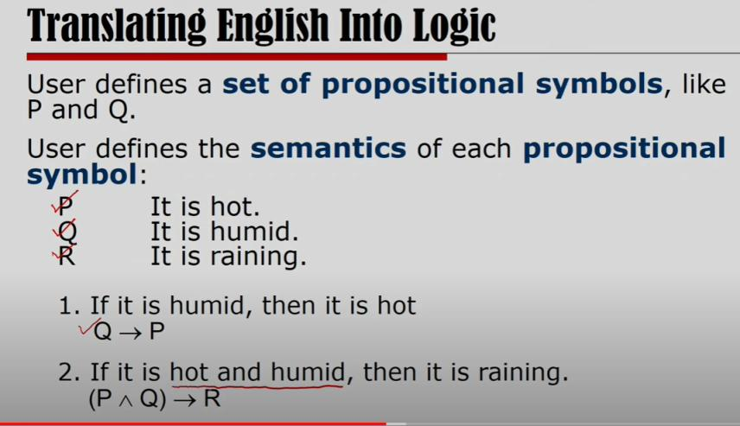

Slide 30
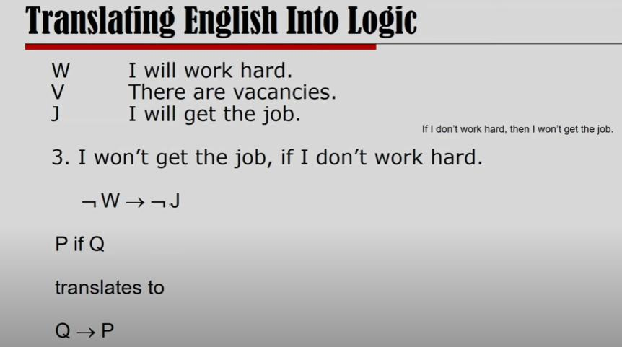

Slide 31
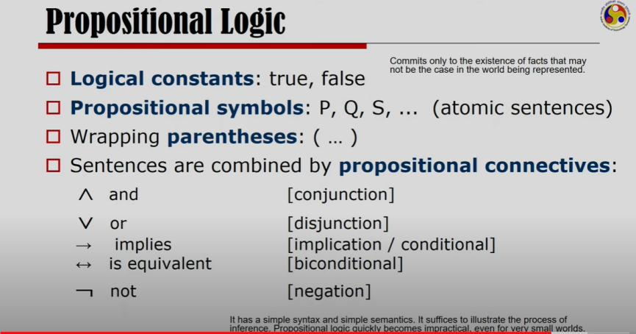

Slide 32
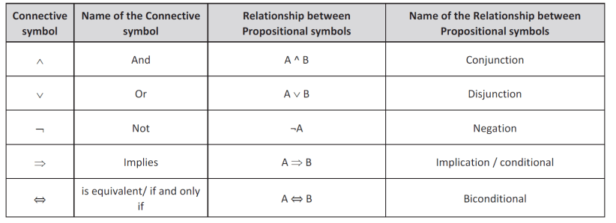
Propositional logic
Propositional logic makes use of relationships between propositions and it is denoted by connectives, if A and B are propositions. Connectives used in proposition logic can be seen in the Table

Slide 33
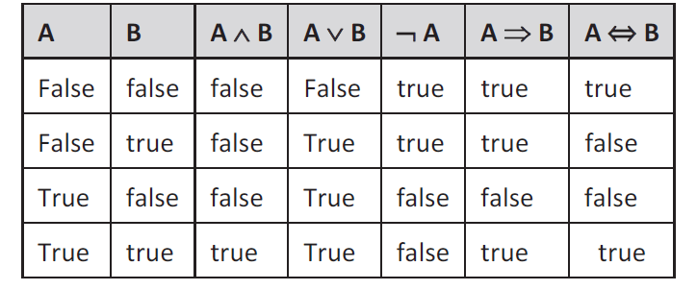
Truth table
To define logical connectives truth tables are used

Slide 34
PL Sentence - Example
Take example of a weather problem.
− Semantics of each propositional symbol can be defined as follows
o Symbol A is a sentence which means “It is hot”.
o Symbol B is a sentence which means “It is humid”.
o Symbol C is a sentence which means “It is raining”.
− We can also choose symbols which are easy to understand, like
o HT for “It is hot”.
o HM for “It is humid”.
o RN for “It is raining”.
− If you have HM → HT then that means “If it is humid, then it is hot”.
If you have (HT ∧ HM) → RN then it means “If it is hot and humid, then it is raining” and so on.

Slide 35
Advantages of Propositional Logic
− Propositional logic is a simple knowledge representation language.
− It is sufficient and efficient technique for solving some artificial intelligence based problems.
− Propositional logic forms the foundation for higher logics like First Order Logic (FOL), etc.

Slide 36
Disadvantages of Propositional Logic
Propositional logic is cannot express complex artificial intelligence problems.
.
− Even if we try to make use of propositional logic to express complex artificial intelligence problems, it can be very wordy and lengthy.
− PL is a weak knowledge representation language because :
o With PL it is hard to identify if the used entity is “individual”. For example : If there are entities like : Priya, Mumbai, 123, etc.
o PL cannot directly represent properties of individual entities or relations between individual entities. For example, Pooja is tall.

Slide 37
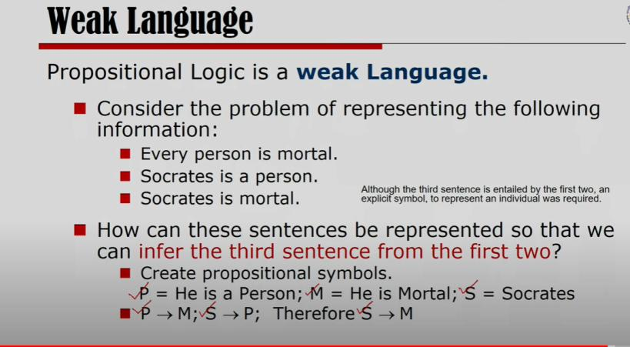

Slide 38
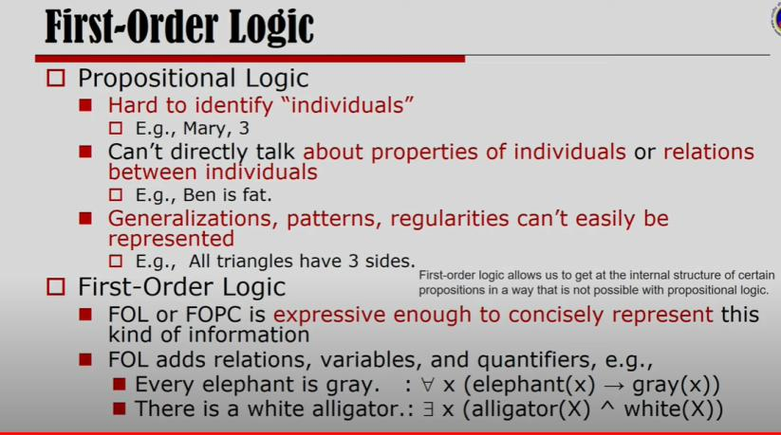

Slide 39
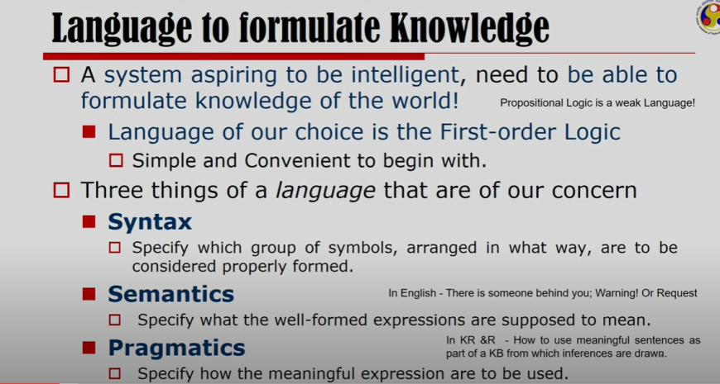

Slide 40
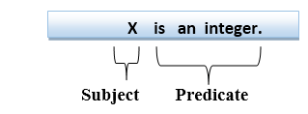
First-order logic statements can be divided into two parts:
Subject: Subject is the main part of the statement.
Predicate: A predicate can be defined as a relation, which binds two atoms together in a statement.
Consider the statement: "x is an integer.", it consists of two parts, the first part x is the subject of the statement and second part "is an integer," is known as a predicate.

Slide 41
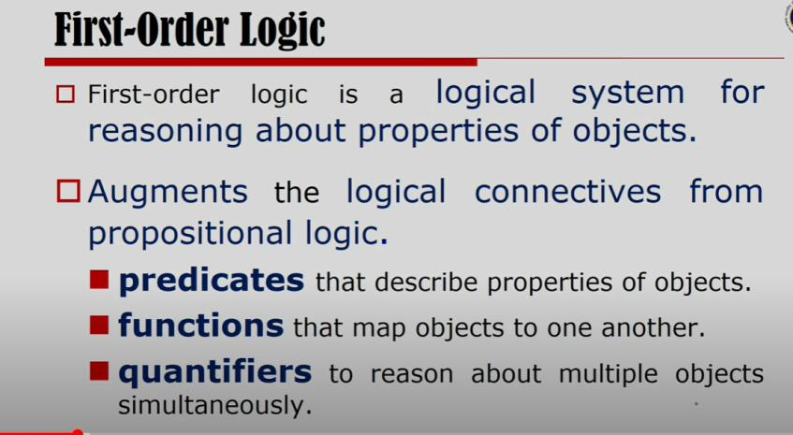

Slide 42
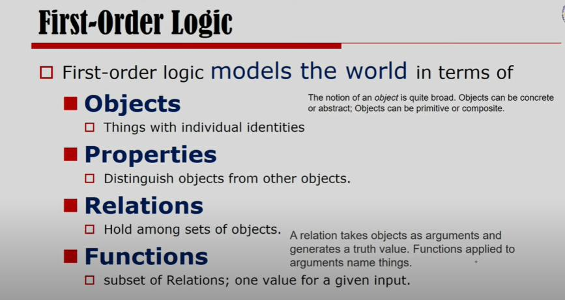

Slide 43
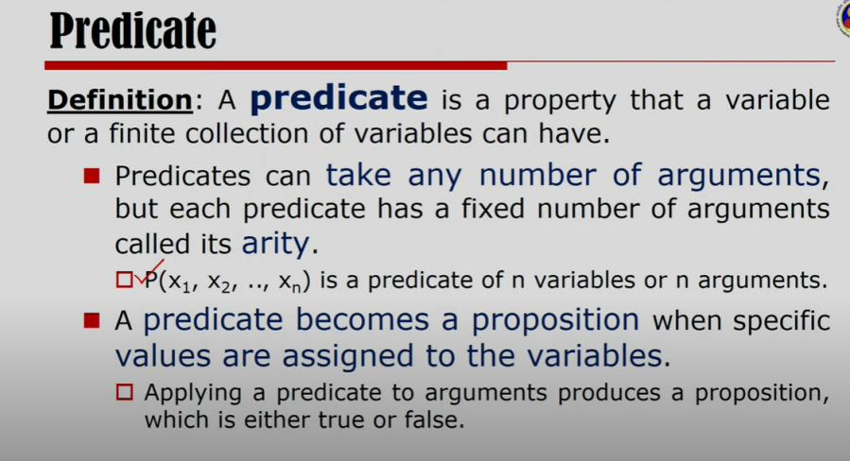

Slide 44
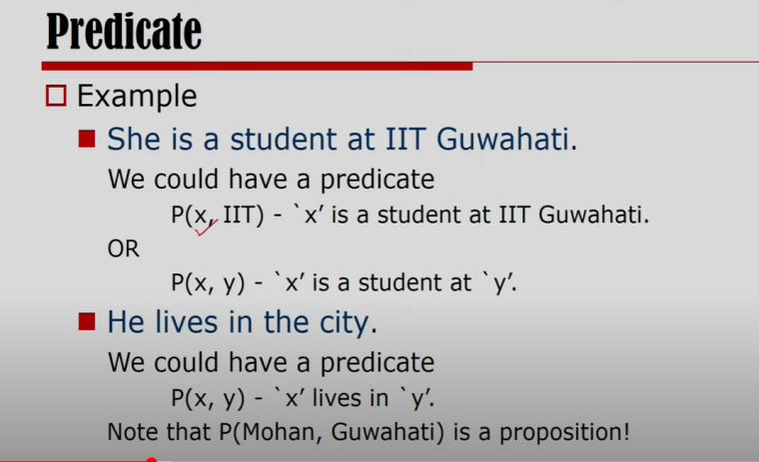

Slide 45
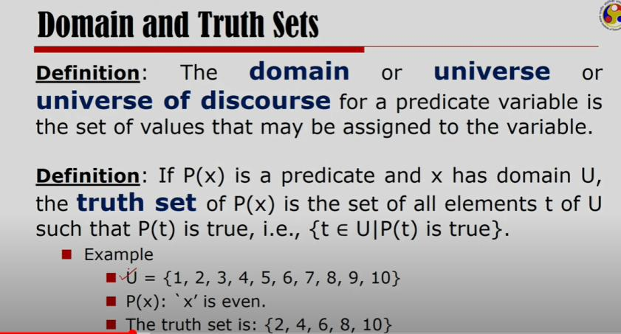

Slide 46
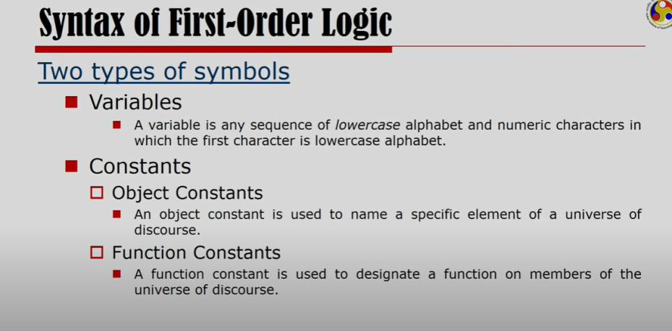

Slide 47
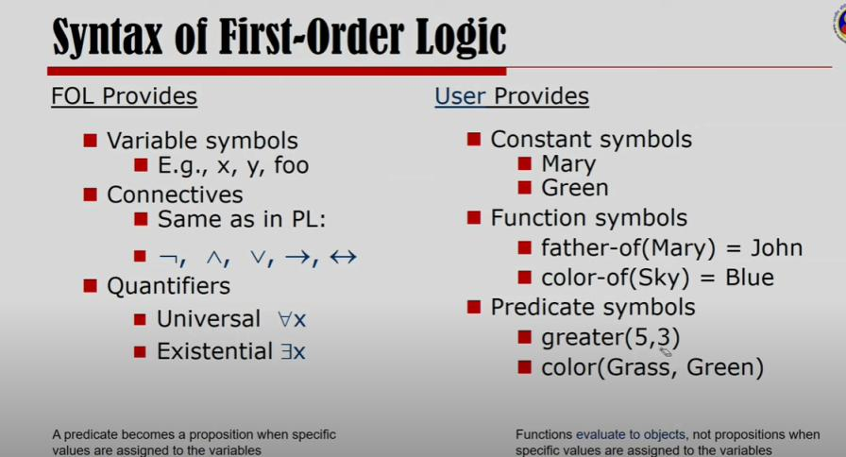

Slide 48
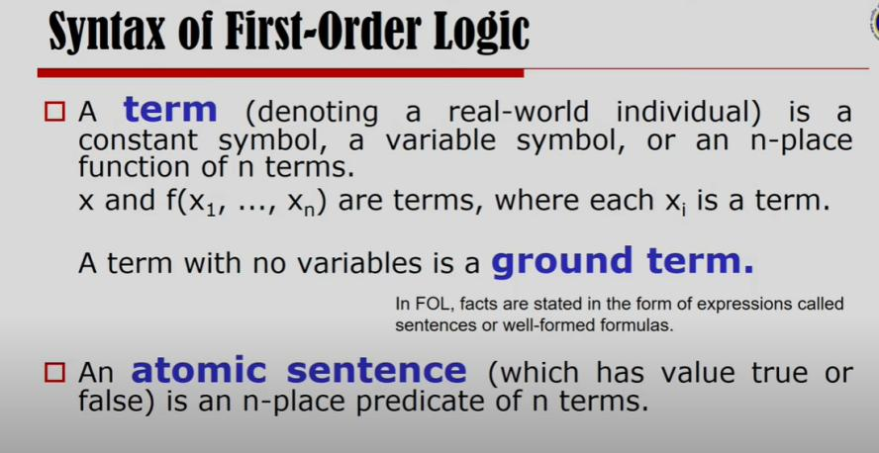

Slide 49
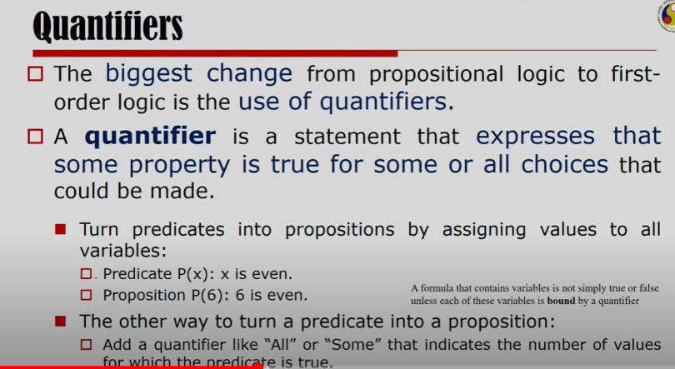

Slide 50
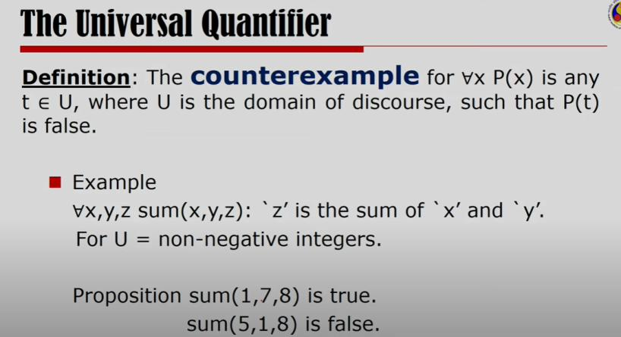

Slide 51
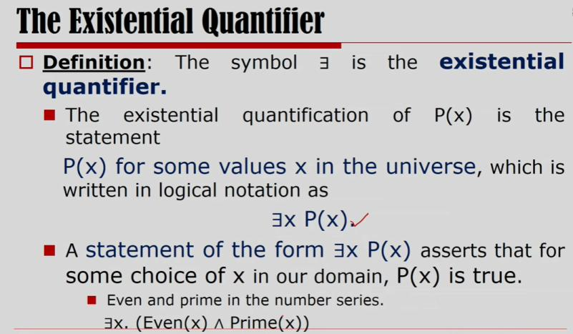

Slide 52
First Order Predicate Logic
In the topic of Propositional logic, we have seen that how to represent statements using propositional logic. But unfortunately, in propositional logic, we can only represent the facts, which are either true or false.
PL is not sufficient to represent the complex sentences or natural language statements. The propositional logic has very limited expressive power. Consider the following sentence, which we cannot represent using PL logic.

Slide 53
First Order Predicate Logic
First-order logic is another way of knowledge representation in artificial intelligence. It is an extension to propositional logic.
FOL is sufficiently expressive to represent the natural language statements in a concise way.
First-order logic is also known as Predicate logic or First-order predicate logic. First-order logic is a powerful language that develops information about the objects in a more easy way and can also express the relationship between those objects.
First-order logic (like natural language) does not only assume that the world contains facts like propositional logic but also assumes the following things in the world:
  Objects: A, B, people, numbers, colors, wars, theories, squares, pits, wumpus, ......
  Relations: It can be unary relation such as: red, round, is adjacent, or n-any relation such as: the sister of, brother of, has color, comes between
  Function: Father of, best friend, third inning of, end of, ......

Slide 54
Topics Covered in the last class
Architecture of Knowledge Base agent
Basic Components of Knowledge Base agent
Ways of representing Knowledge
(a) Logical representations
Proposition Logic
First Order Logic
(b) Production rule representations
(c) Semantic networks

Slide 55
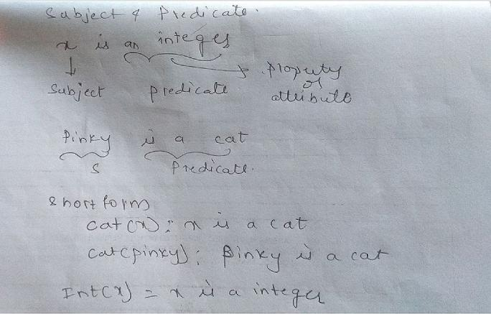

Slide 56
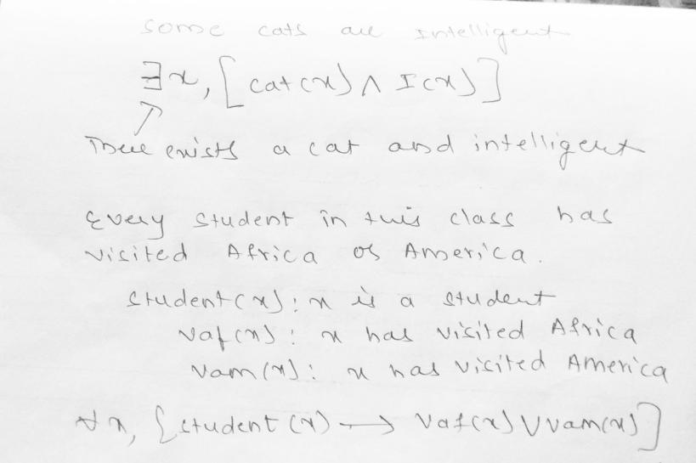

Slide 57
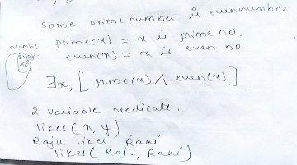

Slide 58
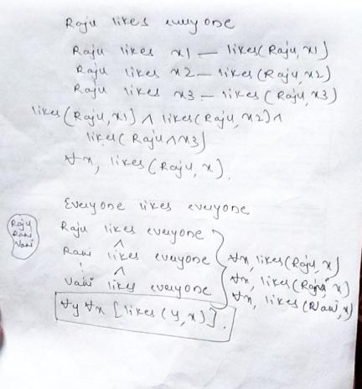

Slide 59
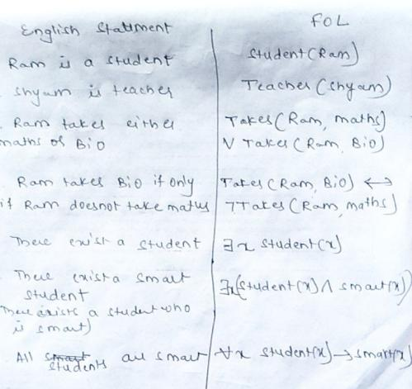

Slide 60
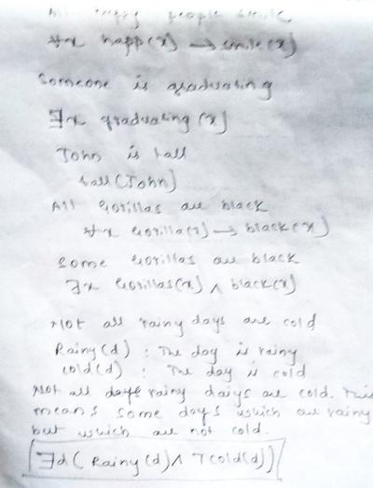

Slide 61
Every gardener likes the sun.
(Ax) gardener(x) => likes(x,Sun)
All purple mushrooms are poisonous.
(Ax) (mushroom(x) ^ purple(x)) => poisonous(x)
Deb is not tall.
~tall(Deb)

Slide 62
Basic Elements of First-order logic:
Constant | 1, 2, A, John, Mumbai, cat,....
Variables | x, y, z, a, b,....
Predicates | Brother, Father, >,....
Function | sqrt, LeftLegOf, ....
Connectives | ∧, ∨, ¬, ⇒, ⇔
Equality | ==
Quantifier | ∀, ∃

Slide 63
First-order logic statements can be divided into two parts:
Subject: Subject is the main part of the statement.
Predicate: A predicate can be defined as a relation, which binds two atoms together in a statement.
Consider the statement: "x is an integer.", it consists of two parts, the first part x is the subject of the statement and second part "is an integer," is known as a predicate.

Slide 64
Quantifiers in First-order logic:
A quantifier is a language element which generates quantification, and quantification specifies the quantity of specimen in the universe of discourse.
These are the symbols that permit to determine or identify the range and scope of the variable in the logical expression. There are two types of quantifier:
  Universal Quantifier, (for all, everyone, everything)
  Existential quantifier, (for some, at least one).

Slide 65
Inference engine:
The inference engine is the component of the intelligent system in artificial intelligence, which applies logical rules to the knowledge base to infer new information from known facts.
Inference engine commonly proceeds in two modes, which are:
Forward chaining
Backward chaining

Slide 66
A. Forward Chaining
Forward chaining is a form of reasoning which start with atomic sentences in the knowledge base and applies inference rules (Modus Ponens) in the forward direction to extract more data until a goal is reached.
The Forward-chaining algorithm starts from known facts, triggers all rules whose premises are satisfied, and add their conclusion to the known facts. This process repeats until the problem is solved.
Properties of Forward-Chaining:
It is a down-up approach, as it moves from bottom to top.
It is a process of making a conclusion based on known facts or data, by starting from the initial state and reaches the goal state.
Forward-chaining approach is also called as data-driven as we reach to the goal using available data.

Slide 67
Forward Chaining
Example:
"As per the law, it is a crime for an American to sell weapons to enemy nations. Country Nono, an enemy of America, has some missiles, and all the missiles were sold to Nono by Colonel, who is an American citizen."
Prove that " Colonel is criminal."
To solve the above problem, first, we will convert all the above facts into first-order definite clauses, and then we will use a forward-chaining algorithm to reach the goal.

Slide 68
Facts Conversion into FOL:
It is a crime for an American to sell weapons to a enemy nations. (Let's say p, q, and r are variables)
American (p) ∧ weapon(q) ∧ sells (p, q, r) ∧ enemy(r, America) → Criminal(p) ...(1)
Country Nono has some missiles.
Owns(A, T1) ......(2)
Missile(T1) .......(3)
All of the missiles were sold to country A by Robert.
Missiles(p) ∧ Owns (A, p) → Sells (Robert, p, A) -------(4)
Missiles are weapons.
Missile(p) → Weapons (p) .......(5)

Slide 69
Country A is an enemy of America.
Enemy (A, America) .........(6)
Robert is American
American(Robert). ..........(7)

Slide 70
Given facts are as follows:
1. It is a crime for an American to sell weapons to the enemy of America.
2. Country Nono is an enemy of America.
3. Nono has some missiles.
4. All the missiles were sold to Nono by Colonel West.
5. Missile is a weapon.
6. Colonel West is American.
− We have to prove that West is a criminal.

Slide 71
FOL
1. It is a crime for an American to sell weapons to the enemy nations.
American(x) Λ Weapon(y) Λ sell (x, y, z) Λ enemy(z, America) => Criminal (x)
2. Country Nono is an enemy of America.
Enemy (Nono, America)
3. Nono has some missiles.
Owns (Nono, x)
Missile(x)
4. All the missiles were sold to Nono by Colonel West.
Missile(x)Λ owns(Nono, x)=> Sell(West, x, Nono)
5. Missile is a weapon.
Missile(x)=> weapon(x)
6. Colonel West is American.
American (West)

Slide 72
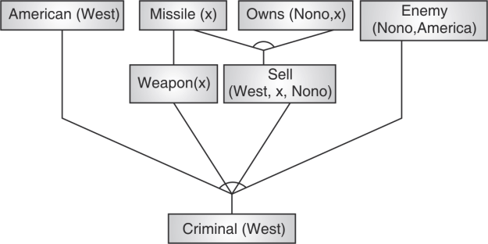
FOL

Slide 73
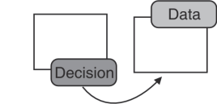
Backward Chaining
If based on the decision the initial data is fetched, then it is called as backward chaining. Backward chaining or
goal-driven inference works towards a final state, and by looking at the working memory to see if goal already there
For example, If while going out one has taken umbrella. Then based on this decision it can be guessed that it is raining.
Here, “taking umbrella” is a decision based on which the data is generated that “it's raining”. This process is backward chaining. “Backward chaining” is called as a decision-driven or goal-driven inference technique.

Slide 74
Backward Chaining
Given
− Rule : human(A) → mortal(A)
− Data : human(Mandela)
− To prove : mortal (Mandela)
Backward Chaining Solution
− mortal (Mandela) will be matched with mortal (A) which gives human (A) i.e. human (Mandela) which is also a given fact.
Hence proved.
− It makes use of right hand side matching. backward chaining is used by the “diagnostic expert systems”, because it
performs operations in a backward direction (i.e. from end to start).

Slide 75
Backward Chaining
1. It is a crime for an American to sell weapons to the enemy nations.
American(x) Λ Weapon(y) Λ sell (x, y, z) Λ enemy(z, America) => Criminal (x)
2. Country Nono is an enemy of America.
Enemy (Nono, America)
3. Nono has some missiles.
Owns (Nono, x)
Missile(x)
4. All the missiles were sold to Nono by Colonel West.
Missile(x)Λ owns(Nono, x)=> Sell(West, x, Nono)
5. Missile is a weapon.
Missile(x)=> weapon(x)
6. Colonel West is American.
American (west)

Slide 76
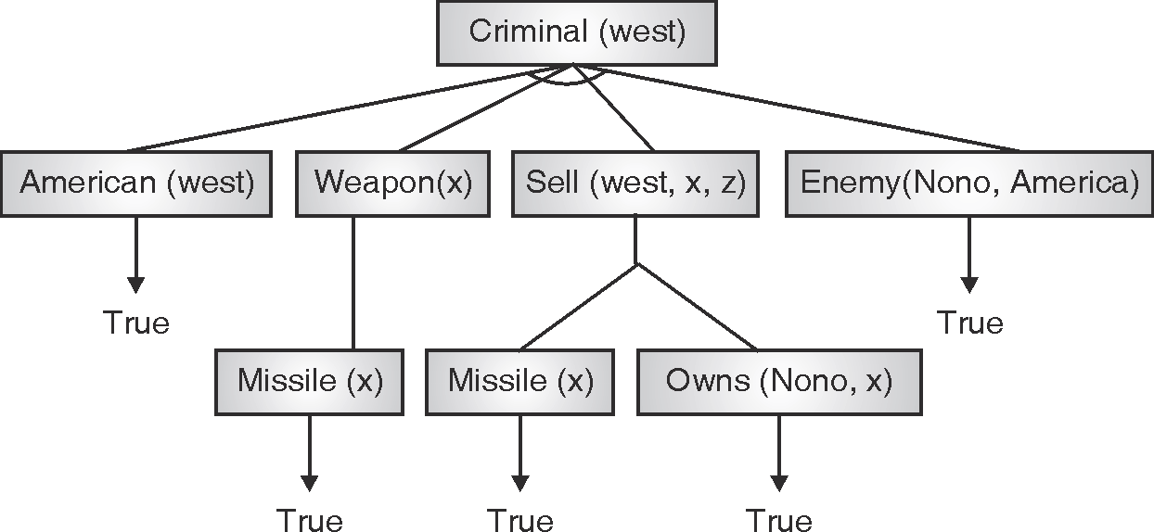
Backward Chaining

Slide 77
Example
Using predicate logic find the course of Anish’s liking for the following :
(i) Anish only likes easy courses.
(ii) Computer courses are hard.
(iii) All electronics courses are easy
(iv) DSP is an electronics course.
Step 1 : Converting given facts to FOL
(i) ∀x : course (x) ∧ easy (x) → likes (Anish, x)
(ii) ∀x : course (x) ∧ computes (x) → hard (x)
(iii) ∀x : course (x) ∧ electronics (x) → easy (x)
(iv) Electronics (DSP)
(v) course (DSP)

Slide 78
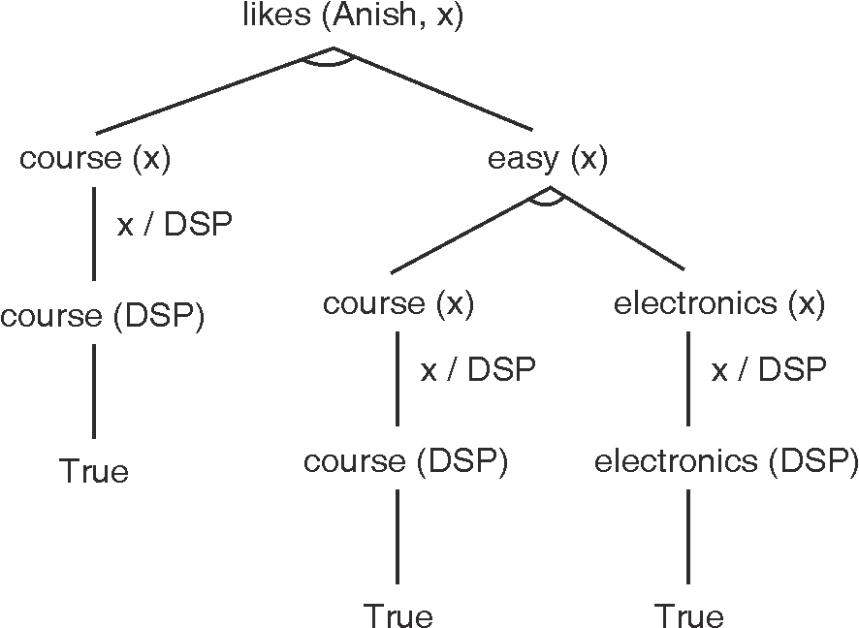
Backward Chaining

Slide 79
Difference between the forward chaining and backward chaining
Forward chaining as the name suggests, start from the known facts and move forward by applying inference rules to extract more data, and it continues until it reaches to the goal, whereas backward chaining starts from the goal, move backward by using inference rules to determine the facts that satisfy the goal.
Forward chaining is called a data-driven inference technique, whereas backward chaining is called a goal-driven inference technique.
Forward chaining is known as the down-up approach, whereas backward chaining is known as a top-down approach.
Forward chaining uses breadth-first search strategy, whereas backward chaining uses depth-first search strategy.
Forward and backward chaining both applies Modus ponens inference rule.
Forward chaining can be used for tasks such as planning, design process monitoring, diagnosis, and classification, whereas backward chaining can be used for classification and diagnosis tasks.
Forward chaining can be like an exhaustive search, whereas backward chaining tries to avoid the unnecessary path of reasoning.
In forward-chaining there can be various ASK questions from the knowledge base, whereas in backward chaining there can be fewer ASK questions.
Forward chaining is slow as it checks for all the rules, whereas backward chaining is fast as it checks few required rules only.

Slide 80
Topics Covered in the last class
Architecture of Knowledge based agent
Representation of Knowledge using Rules
Logical Representation
Production Rule
Semantic Networks
Logical Representation
Propositional Logic (weak logic)
First Order Logic( additional elements)
Inference Rule
Forward chaining
Backward chaining

Slide 81
What is Unification?
Unification is a process of making two different logical atomic expressions identical by finding a substitution. Unification depends on the substitution process.
It takes two literals as input and makes them identical using substitution.
Let Ψ₁ and Ψ₂ be two atomic sentences and 𝜎 be a unifier such that, Ψ₁𝜎 = Ψ₂𝜎, then it can be expressed as UNIFY(Ψ₁, Ψ₂).
Example: Find the MGU(Most General Unifier) for Unify{King(x), King(John)}
Let Ψ₁ = King(x), Ψ₂ = King(John),
Substitution θ = {John/x} is a unifier for these atoms and applying this substitution, and both expressions will be identical.
The UNIFY algorithm is used for unification, which takes two atomic sentences and returns a unifier for those sentences (If any exist).
Unification is a key component of all first-order inference algorithms.
It returns fail if the expressions do not match with each other.
The substitution variables are called Most General Unifier or MGU.

Slide 82
Unification
E.g. Let's say there are two different expressions, P(x, y), and P(a, f(z)).
In this example, we need to make both above statements identical to each other. For this, we will perform the substitution.
P(x, y)......... (i)
P(a, f(z))......... (ii)
Substitute x with a, and y with f(z) in the first expression, and it will be represented as a/x and f(z)/y.
With both the substitutions, the first expression will be identical to the second expression and the substitution set will be: [a/x, f(z)/y].

Slide 83
Literal 1 | Literal 2 | Result of Unify
parents(x, father(x), mother(Bill)) | parents(Bill, father(Bill), y) | {x/Bill, y/mother(Bill)}
parents(x, father(x), mother(Bill)) | parents(Bill, father(y), z) | {x/Bill, y/Bill, z/mother(Bill)}
parents(x, father(x), mother(Jane)) | parents(Bill, father(y), mother(y)) | Failure

Slide 84
Conditions for Unification:
Following are some basic conditions for unification:
Predicate symbol must be same, atoms or expression with different predicate symbol can never be unified.
Number of Arguments in both expressions must be identical.
Unification will fail if there are two similar variables present in the same expression.

Slide 85
Implementation of the Algorithm
Step.1: Initialize the substitution set to be empty.
Step.2: Recursively unify atomic sentences:
Check for Identical expression match.
If one expression is a variable v_{i}, and the other is a term t_{i} which does not contain variable v_{i}, then:
  Substitute t_{i} / v_{i} in the existing substitutions
  Add t_{i} /v_{i} to the substitution setlist.
  If both the expressions are functions, then function name must be similar, and the number of arguments must be the same in both the expression.

Slide 86
Examples
1. Find the Unifier of {p(f(a), g(Y)) and p(X, X)}
Sol: S₀ => Here, Ψ₁ = p(f(a), g(Y)), and Ψ₂ = p(X, X)
SUBST θ= {f(a) / X}
S1 => Ψ₁ = p(f(a), g(Y)), and Ψ₂ = p(f(a), f(a))
SUBST θ= {f(a) / g(y)}, Unification failed.
Unification is not possible for these expressions.

Slide 87
MGU-Most General Unifier
Find the MGU of {p(b, X, f(g(Z))) and p(Z, f(Y), f(Y))}
Here, Ψ₁ = p(b, X, f(g(Z))) , and Ψ₂ = p(Z, f(Y), f(Y))
S₀ => { p(b, X, f(g(Z))); p(Z, f(Y), f(Y))}
SUBST θ={b/Z}
S₁ => { p(b, X, f(g(b))); p(b, f(Y), f(Y))}
SUBST θ={f(Y) /X}
S₂ => { p(b, f(Y), f(g(b))); p(b, f(Y), f(Y))}
SUBST θ= {g(b) /Y}
S₂ => { p(b, f(g(b)), f(g(b)); p(b, f(g(b)), f(g(b))}
Unified Successfully.
And Unifier = { b/Z, f(Y) /X , g(b) /Y}.

Slide 88
MGU-Most General Unifier
Find the MGU of {p (X, X), and p (Z, f(Z))}
Here, Ψ₁ = {p (X, X), and Ψ₂ = p (Z, f(Z))
S₀ => {p (X, X), p (Z, f(Z))}
SUBST θ= {Z/X}
S1 => {p (Z, Z), p (Z, f(Z))}
SUBST θ= {f(Z) / Z}, Unification Failed.

Slide 89
MGU-Most General Unifier
Find the MGU of UNIFY(prime (11), prime(y))
Here, Ψ₁ = {prime(11) , and Ψ₂ = prime(y)}
S₀ => {prime(11) , prime(y)}
SUBST θ= {11/y}
S₁ => {prime(11) , prime(11)} , Successfully unified.
Unifier: {11/y}.

Slide 90
MGU-Most General Unifier
Find the MGU of Q(a, g(x, a), f(y)), Q(a, g(f(b), a), x)}
Here, Ψ₁ = Q(a, g(x, a), f(y)), and Ψ₂ = Q(a, g(f(b), a), x)
S₀ => {Q(a, g(x, a), f(y)); Q(a, g(f(b), a), x)}
SUBST θ= {f(b)/x}
S₁ => {Q(a, g(f(b), a), f(y)); Q(a, g(f(b), a), f(b))}
SUBST θ= {b/y}
S₁ => {Q(a, g(f(b), a), f(b)); Q(a, g(f(b), a), f(b))},
Successfully Unified.
Unifier: [a/a, f(b)/x, b/y].

Slide 91
UNIFY(knows(Richard, x), knows(Richard, John))
Here, Ψ₁ = knows(Richard, x), and Ψ₂ = knows(Richard, John)
S₀ => { knows(Richard, x); knows(Richard, John)}
SUBST θ= {John/x}
S₁ => { knows(Richard, John); knows(Richard, John)},
Successfully Unified.
Unifier: {John/x}.

Slide 92
Resolution in FOL
Resolution is used, if there are various statements are given, and we need to prove a conclusion of those statements. Unification is a key concept in proofs by resolutions.
Steps for Resolution:
Conversion of facts into first-order logic.
Convert FOL statements into CNF
Negate the statement which needs to prove (proof by contradiction)
Draw resolution graph (unification).

Slide 93
Convert FOL statements into CNF
Eliminate biconditionals and implications:
• Eliminate ⇔, replacing α ⇔ β with (α ⇒ β) ∧ (β ⇒ α).
• Eliminate ⇒, replacing α ⇒ β with ¬α ∨ β.
2. Move ¬ inwards:
• ¬(∀ x p) ≡ ∃ x ¬p,
• ¬(∃ x p) ≡ ∀ x ¬p,
• ¬(α ∨ β) ≡ ¬α ∧ ¬β,
• ¬(α ∧ β) ≡ ¬α ∨ ¬β,
• ¬¬α ≡ α.

Slide 94
Convert FOL statements into CNF
3. Standardize variables apart by renaming them:
each quantifier should use a different variable.
4. Skolemize: each existential variable is replaced by a Skolem constant.
• For instance, ∃x Rich(x) becomes Rich(G1) where G1 is a new Skolem constant.

Slide 95
Convert FOL statements into CNF
5. Drop universal quantifiers
• For instance, ∀ x Person(x) becomes Person(x).
6. Distribute ∧ over ∨: • (α ∧ β) ∨ γ ≡ (α ∨ γ) ∧ (β ∨ γ).

Slide 96
Resolution in FOL
To better understand all the above steps, we will take an example in which we will apply resolution.
Example:
John likes all kind of food.
Apple and vegetable are food
Anything anyone eats and not killed is food.
Anil eats peanuts and still alive
Harry eats everything that Anil eats.
Prove by resolution that:
John likes peanuts.

Slide 97
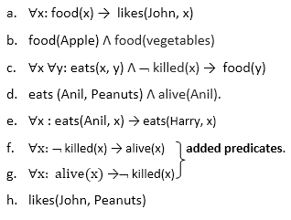
Step-1: Conversion of Facts into FOL
In the first step we will convert all the given statements into its first order logic.
John likes all kind of food.
Apple and vegetable are food
Anything anyone eats and not killed is food.
Anil eats peanuts and still alive
Harry eats everything that Anil eats.
Prove by resolution that:
John likes peanuts.

Slide 98

Step-2: Conversion of FOL into CNF
In First order logic resolution, it is required to convert the FOL into CNF as CNF form makes easier for resolution proofs.
Eliminate all implication (→) and rewrite
Replace P → Q with ¬P V Q
∀x ¬ food(x) V likes(John, x)
food(Apple) Λ food(vegetables)
∀x ∀y ¬ [eats(x, y) Λ ¬ killed(x)] V food(y)
eats (Anil, Peanuts) Λ alive(Anil)
∀x ¬ eats(Anil, x) V eats(Harry, x)
∀x¬ [¬ killed(x) ] V alive(x)
∀x ¬ alive(x) V ¬ killed(x)
likes(John, Peanuts).

Slide 99
Move negation (¬)inwards and rewrite-Replace ¬ ¬P with P, ¬(PV Q) with ¬P Λ ¬Q and so on.
  ∀x ¬ food(x) V likes(John, x)
  food(Apple) Λ food(vegetables)
  ∀x ∀y ¬ eats(x, y) V killed(x) V food(y)
  eats (Anil, Peanuts) Λ alive(Anil)
  ∀x ¬ eats(Anil, x) V eats(Harry, x)
  ∀x ¬killed(x) ] V alive(x)
  ∀x ¬ alive(x) V ¬ killed(x)
  likes(John, Peanuts).

Slide 100
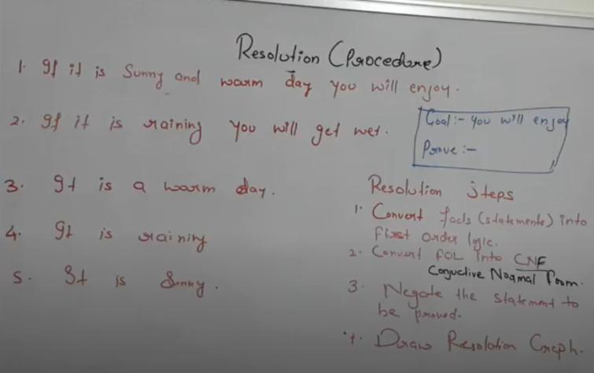
To better understand all the above steps, we will take an example in which we will apply resolution.

Slide 101
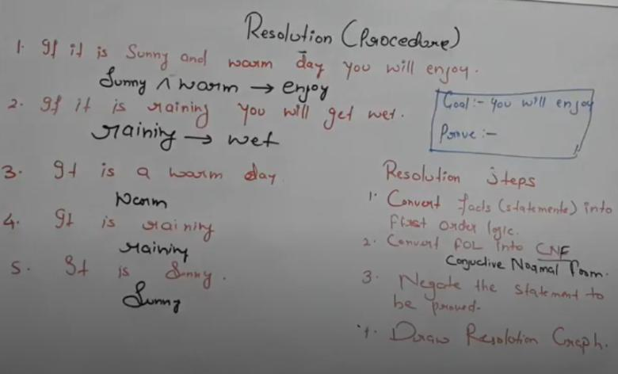

Slide 102
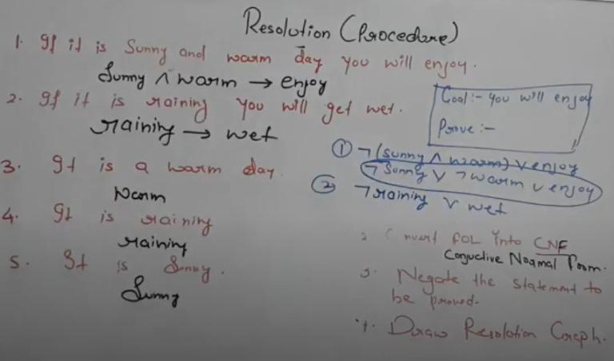

Slide 103
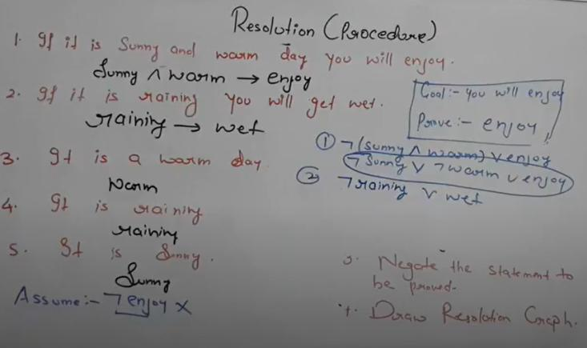

Slide 104


Slide 105


Slide 106


Slide 107


Slide 108
Convert following propositional logic statement into CNF.
A→ ( B→ C) MU - Dec. 15, 4 Marks
FOL : A → (B ↔ C)
Normalizing the given statement.
(i) A → (B → C ∧ C → B)
(ii) (A → (B → C)) ∧ (A → (C → B))
Converting to CNF.
Applying Rule, α → β ≡ ∼ α ∨ β
∼ A ∨ (∼ B ∨ C) ∧ ∼ A ∨ (∼ C ∨ B)
i.e. ∼ A ∨ ((∼ B ∨ C) ∧ (∼ C ∨ B))

Slide 109
Example on Resolution
1. It is a crime for an American to sell weapons to the enemy nations.
American(x) Λ Weapon(y) Λ sell (x, y, z) Λ enemy(z, America) => Criminal (x)
2. Country Nono is an enemy of America.
Enemy (Nono, America)
3. Nono has some missiles.
Owns (Nono, x)
Missile(x)
4. All the missiles were sold to Nono by Colonel West.
Missile(x)Λ owns(Nono, x)=> Sell(West, x, Nono)
5. Missile is a weapon.
Missile(x)=> weapon(x)
6. Colonel West is American.
American (west)

Slide 110
Example on Resolution
Step 2 : Lets convert them to CNF
1. ~ American(x) V ~ Weapon(y) V~ sell (x, y, z) V ~ enemy(z, America)
V Criminal (x)
2. Enemy (Nono, America)
3. Owns (Nono, x)
4. Missile(x)
5. ~ Missile(x) V ~ owns(Nono, x) V Sell(West, x, Nono)
6. ~Missile(x) V weapon(x)
7. American (West)

Slide 111


Slide 112


Slide 113
Resolution in FOL
Resolution is used, if there are various statements are given, and we need to prove a conclusion of those statements. Unification is a key concept in proofs by resolutions.
Steps for Resolution:
Conversion of facts into first-order logic.
Convert FOL statements into CNF
Negate the statement which needs to prove (proof by contradiction)
Draw resolution graph (unification).

Slide 114
Convert FOL statements into CNF
Eliminate biconditionals and implications:
• Eliminate ⇔, replacing α ⇔ β with (α ⇒ β) ∧ (β ⇒ α).
• Eliminate ⇒, replacing α ⇒ β with ¬α ∨ β.
2. Move ¬ inwards:
• ¬(∀ x p) ≡ ∃ x ¬p,
• ¬(∃ x p) ≡ ∀ x ¬p,
• ¬(α ∨ β) ≡ ¬α ∧ ¬β,
• ¬(α ∧ β) ≡ ¬α ∨ ¬β,
• ¬¬α ≡ α.

Slide 115
Consider following statements.
1. Rimi is hungry.
2. If Rimi is hungry she barks.
3. If Rimi is barking then Raja is angry.
Explain statements in predicate logic. Convert them into CNF form.
Prove that Raja is angry using resolution.

Slide 116
Step 1 : Converting given facts to FOL.
1. Hungry (Rimi)
2. Hungry (Rini) → barks (Rimi)
3. Barks (Rimi) → angry (Raja)

Slide 117
Step 2 : Converting FOL statements to CNF.
1. Hungry (Rimi)
2. ∼ hungry (Rimi) ∨ barks (Rimi)
3. ∼ barkes (Rimi) ∨ angry (Raja)
Step 3 : Negate the stament to be proved
Angry (Raja)
Negation : ∼ Angry (Raja)

Slide 118

This shows that our assumption is Wrong. Hence proved that Raja is Angry.

Slide 119
Example
Consider following statements :
(a) Ravi Likes all kind of food.
(b) Apple and Chicken are food
(c) Anything anyone eats and is not killed is food.
(d) Ajay eats peanuts and still alive.
(e) Rita eats everything that Ajay eats.
Prove that Ravi Likes Peanuts using resolution. What food does Rita eat

Slide 120
(A) Proof by Resolution
Step 1 : Convert given facts to FOL
(a) ∨ x, food (x) → likes (Ravi, x)
(b) food (Apple)
(c) food (Chicken)
(d) ∨ x ∨y : eats (x, y) ∧ ∼ killed (x) → food (y)
(e) eats (Ajay, Peanuts) ∧ alive (Ajay)
(f) ∨x : eats (Ajay, x) → eats (Rita, x)
In this case we have to add few common sense predicate which are always true.
(g) ∨x : ∼ killed (x) → alive (x)
(h) ∨ x : alive (x) → ∼ killed (x)

Slide 121
Step 2 : Converting FOLs to CNF
(a) ∼ food (x) ∨ likes (Ravi, x)
(b) food (Apple)
(c) food (Chicken)
(d) ∼ eats (x, y) ∨ killed (x) ∨ food (y)
(e) eats (Ajay, Peanuts)
(f) alive (Ajay)
(g) ∼ eats (Ajay, x) ∨ eats (Rita, x)
(h) killed (x) ∨ alive (x)
(i) ∼ alive (x) ∨ ∼killed (x)
Step 3 : Negate the statement to be proved.
∼ likes (Ravi, Peanuts)

Slide 122

As the result of this resolution is NIL, it means out assumption is wrong. Hence proved that “Ravi likes Peanuts”.

Slide 123

Proof by backward chaining : (Referring to FOLs of Step 2)
Hence the answer is Rita eats peanuts.

Slide 124
Example
Consider following facts.
1. If maid stole the jewelry then butler was not guilty.
2. Either maid stole the jewelry or she milked the cow.
3. If maid milked the cow then butler got the cream.
4. Therefore if butler was guilty then he got the cream.
Prove the conclusion (step 4) is valid using resolution.

Slide 125
Step 1 : Converting given facts to FOL.
1. steal (maid, jewelry) → ∼ guilty (butler)
2. steal (maid, jewelry) ∨ milk (maid, cow)
3. milk (maid, cow) → got_Cream (butler)
To prove that
4. guilty (butler) → got_cream (butter)

Slide 126
Step 2 : Converting FOL to CNF.
1. ∼ steal (maid, jwellary) ∨ ∼ guilty (butler)
2. steal (maid, jwellary) ∨ milk (maid, cow)
3. ∼ milk (maid, cow) ∨ got_cream (butler)
4. ∼ guilty (butler) ∨ got_cream (butler)

Slide 127
Step 3 : Negate the proof sentence
As sentence 4 is the one to be proved.
guilty (butler) ∧ ∼ got_ cream (butler)

Slide 128


Slide 129
MU-Dec. 15, 12 Marks
Consider following axioms.
All people who are graduating are happy.
All happy people smile.
Someone is graduating.
(i) Represent these axioms in FOL.
(ii) Convert each formula to CNF.
(iii) Prove that someone is smiling using resolution technique. Draw the resolution tree.

Slide 130
Step 1 : Converting axioms to FOL.
(i) ∀x : graduating (x) → happy (x).
(ii) ∀x : happy (x) → smile (x)
(iii) ∃x : graduating (x)
Step 2 : Converting FOL to CNF.
(i) ∼ graduating (x) ∨ happy (x)
(ii) ∼ happy (x1) ∨ smile (x1)
(iii) graduating (x2)

Slide 131
Step 3 : x3 smile (x3)
Negating the stmt
∼ smile (x3)

Slide 132


Slide 133
Consider the following Knowledge Base:
The humidity is high or the sky is cloudy.
If the sky is cloudy, then it will rain.
If the humidity is high, then it is hot.
It is not hot.
Goal: It will rain.

Slide 134
Let, P: Humidity is high.
Q: Sky is cloudy.
It will be represented as P V Q.
2) Q: Sky is cloudy. …from(1)
Let, R: It will rain.
It will be represented as Q → R.
3) P: Humidity is high. …from(1)
Let, S: It is hot.
It will be represented as P → S.
4) ¬S: It is not hot.

Slide 135
Applying resolution method:
In (2), Q → R will be converted as (¬Q V R)
In (3), P → S will be converted as (¬P V S)
Negation of Goal (¬R): It will not rain.

Slide 136
The WUMPUS World Environment
WUMPUS is an early computer game also known as “Hunt the Wumpus”. WUMPUS was developed by Gregory Yob in 1972/1973. It was originally written in BASIC (Beginner's All-purpose Symbolic Instruction Code).
− WUMPUS is a map-based game. Let's understand the game :
WUMPUS world is like a cave, which represents number of rooms, rooms, which are connected by passageways.
We will take a 4 × 4 grid to understand the game.
WUMPUS is a monster who lives in one of the rooms of the cave. WUMPUS eats the player (agent) if player
(agent) comes in the same room. Fig. shows that room (3, 1) where WUMPUS is staying.
Player (agent) starts from any random position in cave and has to explore the cave. We are starting from (1, 1) position.
− There are various sprites in the game like pit, stench, breeze, gold, and arrow. Every sprite has some feature. Let’s understand this one-by-one :

Slide 137
The WUMPUS World Environment
Few rooms have bottomless pits which trap the player (agent) if he comes to that room. You can see in the Fig. that room (1,3), (3,3) and (4,4) have bottomless pit. Note that even WUMPUS can fall into a pit.
Stench experienced in a room which has a WUMPUS in its neighbourhood room. See the Fig, here room (2,1), (3,2) and (4,1) have Stench.
Breeze is experienced in a room which has a pit in its neighbourhood room. Fig. 3 shows that room (1,2), (1,4), (2,3), (3,2), (3,4) and (4,3) consists of Breeze.
Player (Agent) has arrows and he can shoot these arrows in straight line to kill WUMPUS.
One of the rooms consists of gold, this room glitters. Fig. shows that room (3, 2) has Gold.
Apart from above features player (agent) can accept two types of percepts which are: Bump and scream. A bump is generated if player (agent) walks into a wall. While a sad scream created everywhere in the cave when the WUMPUS is killed.

Slide 138


Slide 139
Description of the WUMPUS World
An agent receives percepts while exploring the rooms of cave. Every percepts can be represented with the help of five element list, which is [stench, breeze, glitter, bump, scream]. Here, player (agent) cannot perceive its own location.
− If the player (agent) gets percept as [Stench, Breeze, None, None, None]. Then it means that there is a stench and a breeze, but no glitter, no bump, and no scream in the WUMPUS world at that position in the game.
− Let's take a look at the actions which can be performed by the player(agent) in WUMPUS World :
o Move : To move in forward direction,
o Turn : To turn right by 90 degrees or left by 90 degrees,
o Grab : To pick up gold if it is in the same room as the player(agent),
o Shoot : To Shoot an arrow in a straight line in the direction faced by the player (agent)

Slide 140
Description of the WUMPUS World
These actions are repeated till the player (agent) kills the WUMPUS or if the player (agent) is killed. If the WUMPUS is killed then it is a winning condition, else if the player (agent) is killed then it is a losing condition and the game is over.
− Game developer can keep a restriction on the number of arrows which can be used by the player (agent). So if we allow agent to have only one arrow, then only the first shoot action will have some effect. If this shoot action kills the WUMPUS then you win the game, otherwise it reduces the probability of winning the game.
− Lastly there is a die action : It takes places automatically if the agent enters in a room with a bottomless pit or in a room with WUMPUS.

Slide 141
Goal of the game
Main aim of the game is that player (agent) should grab the gold and return to starting room (here its (1,1)) without being killed by the monster (WUMPUS).
− Award and punishment points are assigned to a player (Agent) based on the actions it performs. Points can be given as follows :
o 100 points are awarded if player (agent) comes out of the cave with the gold.
o 1 point is taken away for every action taken.
o 10 points are taken away if the arrow is used.
o 200 points are taken away if the player (agent) gets killed.

Slide 142
Give PEAS descriptors for WUMPUS world (May 13, Dec. 14)
1. Performance measure
+ 100 for grabbing the gold and coming back to the starting position,
– 200 if the player (agent) is killed.
– 1 per action,
– 10 for using the arrow.
2. Environment
− Empty Rooms.
− Room with WUMPUS.
− Rooms neighbouring to WUMPUS which are smelly.
− Rooms with bottomless pits
− Rooms neighbouring to bottomless pits which are breezy.
− Room with gold which is glittery.
− Arrow to shoot the WUMPUS.

Slide 143
Give PEAS descriptors for WUMPUS world
Sensors (assuming a robotic agent)
− Camera to get the view
− Odour sensor to smell the stench
− Audio sensor to listen to the scream and bump
4. Effectors (assuming a robotic agent)
− Motor to move left, right
− Robot arm to grab the gold
− Robot mechanism to shoot the arrow

Slide 144

Exploring a WUMPUS World
Let’s try to understand the WUMPUS world problem in step by step manner.
WUMPUS world with player in room (1,1)

Slide 145
Step 1 : Initially the player(agent) is in the room (1,1).
The first percept received by the player is [none, none, none, none, none]. (remember percept consists of
[stench, breeze, glitter, bump, scream])
Player can move to room(1,2) or (2,1) as they are safe cells.
Step 2 : Let us move to room (1,2).

Slide 146

As room (1,1) is visited you can see “V” mark in that room. The player receives following percept : [none, breeze, none, none, none].
− As breeze percept is received room (1,2) is marked with “B” and it can be predicted that there is a bottomless pit in the neighboring room.
− You can see that room (1,3) and room (2,2) is marked with “P?”. So room (1,3) and (2,2) is not safe to move in. Thus player should return to room (1,1) and try to find other, safe room to move to.

Slide 147

Step 3
WUMPUS world with player moving back to room (1,1) and then moves to other safe room (2,1).

Slide 148
As seen in Fig. . Player in now in room (2,1), where it receives a percept as follows : [stench, none, none, none,none] which means that there is a WUMPUS in neighboring room (i.e. either room (2,2) or (3,1) has WUMPUS).
− As we did not get breeze percept in this room, we can understand that room (2,2) cannot have any pit and from step 2
we can understand that room (2,2) cannot have WUMPUS because room (1,2) did not show stench percept.
− Thus room(2,2) is safe to move in.

Slide 149

Step 4 :
Player receives [none, none, none, none, none] percept when it comes to room (2,2). From Fig. you
can understand that room (2,3) and room (3,2) are safe to move in.

Slide 150

Step 5
: Let's move to room (3,2). Here, player receives [stench, breeze, glitter, none, none] percept.
Field 1 of the percept shows that room (3,1), (3,3) and (4,2) can have WUMPUS. Field 2 of the percept shows that room (3,1), (3,3), (2,2) and (4,2) can have bottomless pit. Field 3 of the percept shows that room (3,2) has gold. So, the player grabs the gold first. As the aim of this game is to grab the gold and go back to the starting position, without being killed by the WUMPUS.

Slide 151
Now, we have to go back to the starting position i.e. room (1,1) without getting killed by WUMPUS. From steps 1, 2, 3 and 4 We know that room (1,1), (1,2), (2,1) and (2,2) are safe rooms. so, we can go back to room (1,1) by following any of the two paths : i.e. (2,2), (2,1), (1,1) or (2,2), (1,2), (1,1).

Slide 152

Step 6
As can be seen in Fig. . We will go from room (2,2) to room (2,1) and from room (2,1) to room (1,1).
Thus we won the WUMPUS World game!!!

Slide 153


Slide 154
Important Questions
What is Knowledge Based Agent? Explain with Architecture
Describe WUMPUS WORLD Environment. Specify PEAS properties and type of environment
What is propositional logic? Write syntax and semantics and example sentences for propositional logic.
What is first order logic? Write syntax and semantics of FOL with example.
What is unification
Explain inference process in FOL using Forward Chaining and Backward Chaining.
Write a short note on: Resolution.

